Slide 1


HealSync
One App, Total Care
A complete healthcare companion that brings medicines, lab tests, doctor consultations, and wellness into one seamless experience

Slide 2





The Healthcare Chaos
Users juggle multiple apps and struggle to maintain a complete health picture
App Overload
Lost Data
Switching between multiple platforms for basic health needs
BP and sugar readings scattered across notebooks and devices
Expense Confusion
Missed Reminders
No clear view of monthly or yearly medical spending
Forgotten medicines and skipped checkups

Slide 3
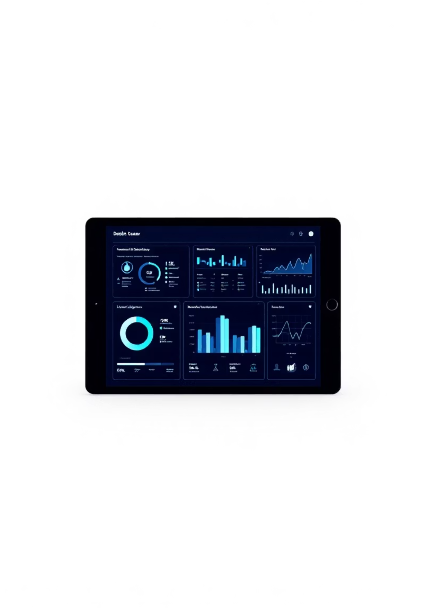

One Platform, Everything Connected
1
All-in-One Access
Medicines, lab tests, consultations, and wellness products unified
2
Visual Health Tracking
Monthly BP and sugar charts with one-year storage
3
Expense Intelligence
Monthly and yearly medical spending at a glance
4
Smart Reminders
Never miss medicines, appointments, or checkups

Slide 4






Design Thinking Journey
Empathize
User interviews reveal healthcare management pain points
Define
Need for integrated, intuitive health platform
Ideate
Expense analytics, reminders, unified data storage
Prototype
Wireframes testing navigation and usability
Test
Real user feedback refines experience

Slide 5


Understanding Our Users
Research Objectives
Key Questions
Uncovering behaviors, frustrations, and needs in digital health management
How do you buy medicines or book lab tests?
Which apps do you use for health checkups?
How do you track BP or sugar levels?
How do you manage medical expenses?
What features are missing from current apps?

Slide 6


Meet Priya
Priya Sharma
Age: 29 | Profession: IT Professional | Location: Bangalore
Goals
Maintain health, manage expenses, access consultations and reports easily
Frustrations
Multiple apps, forgotten medicine schedules, expense tracking difficulty
Needs
One efficient platform with reminders and comprehensive records

Slide 7
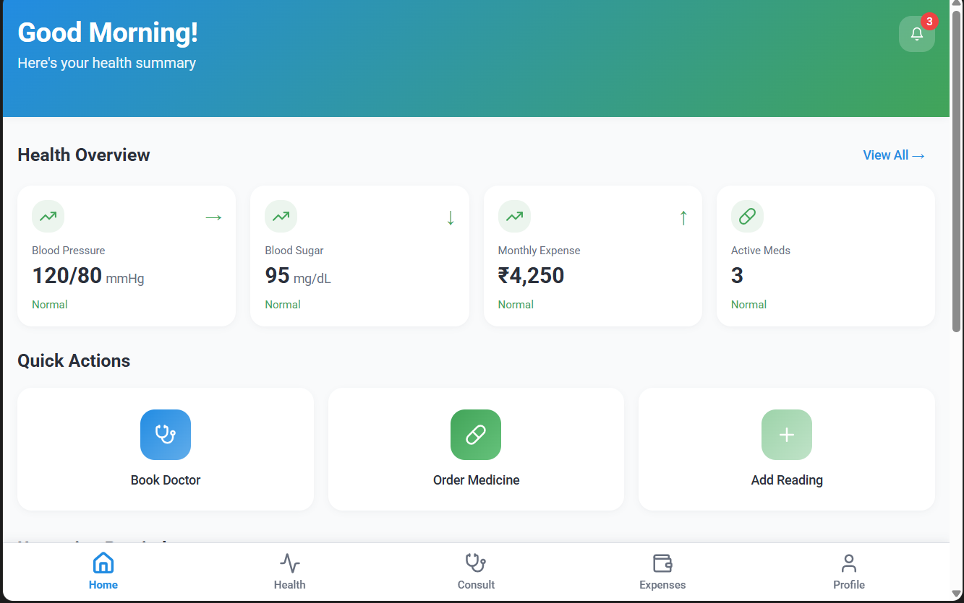

User Journey
A seamless path from opening the app to complete health management
1
Open App
2
View Dashboard
3
Select Service
4
Book Appointment
5
Get Reminder
6
View Results
7
Track Health Data
8
Review Summary

Slide 8

Information Architecture
Eight core sections create a comprehensive health ecosystem
Home Dashboard
Medicines
Your health at a glance
Order and track prescriptions
Lab Tests
Doctor Consultation
Book tests, view reports
Connect with specialists
Health Tracker
Expense Tracker
BP and sugar monitoring
Financial health insights
Reminders
Profile & Settings
Stay on schedule
Personalize your experience

Slide 9







Site Map Structure
Home
Medicines
Search, Order History
Lab Tests
Book Test, Reports
Consultations
Specialties, Appointments
Health Tracker
BP/Sugar, Charts
Expense Tracker
Monthly, Yearly Reports

Slide 10
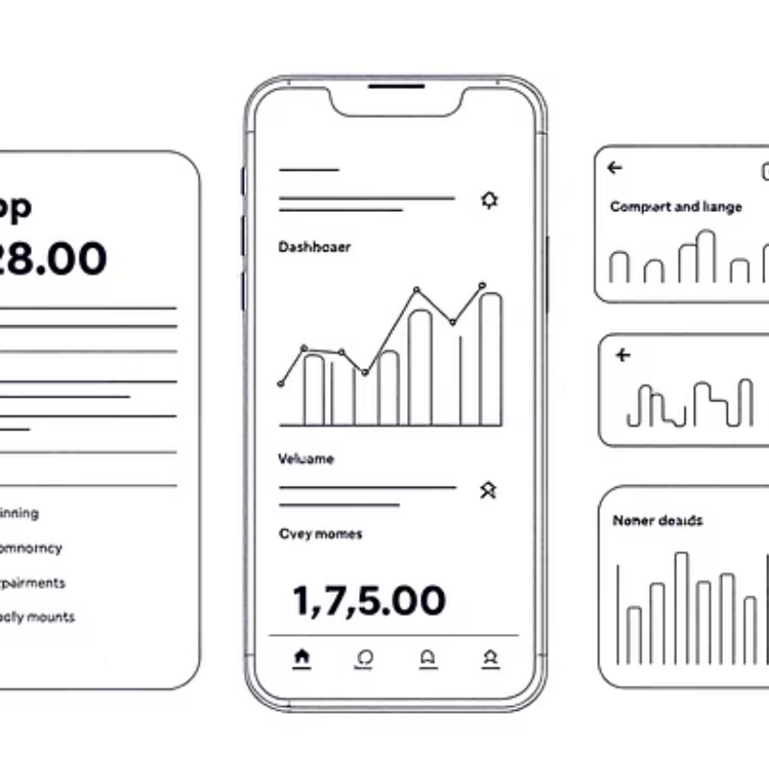
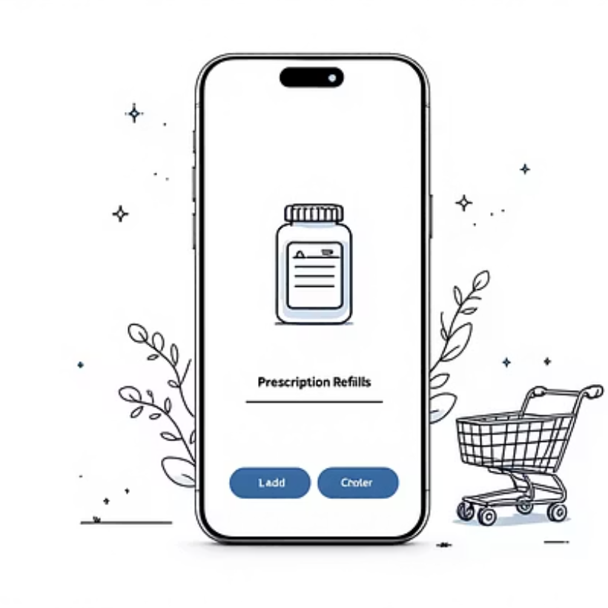
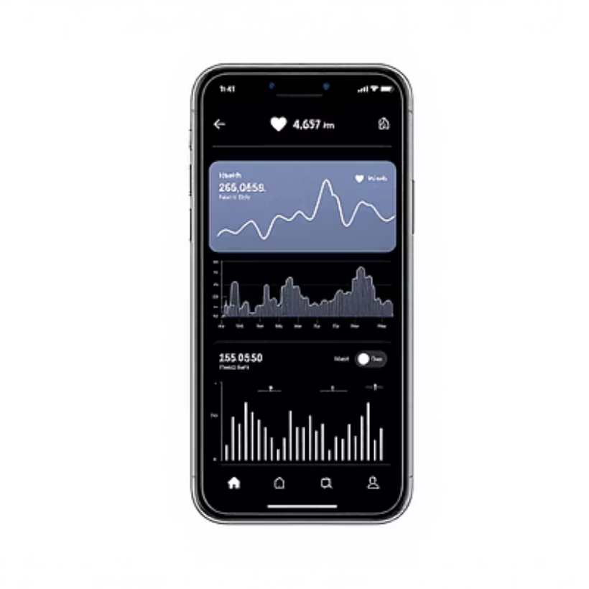
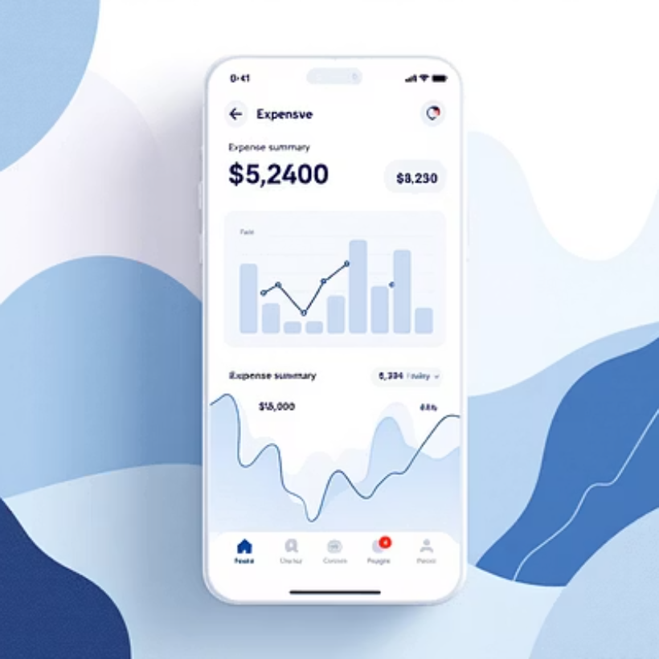

Low-Fidelity & High – Fidelity Wireframes
Early sketches mapping user flows and interface structure
Key Screens: Home Dashboard • Medicine Ordering • Health Tracker • Expense Summary

Slide 12

THANK YOU !
Project Designed By:
Sasirekha V Jyothi shree R
Ilakkiya S Gomathi M
III YEAR - Department of AI&DS
SKP Engineering College, Tiruvannamalai

